Slide 1
DEVICE SHIELD
Smart City GBV
Response System
INCIDENT STATUS
KEYWORD DETECTED
INCIDENT CREATED
Web ecosystem concept and hackathon-ready prototype plan
TRUSTED MEMBERS
EVIDENCE LIVE
Helping survivors silently request help through real-time city intelligence and automated dispatch.
RESOLUTION
WEB ONLY • DEMO MODE • GBV AWARENESS THEME

Slide 2
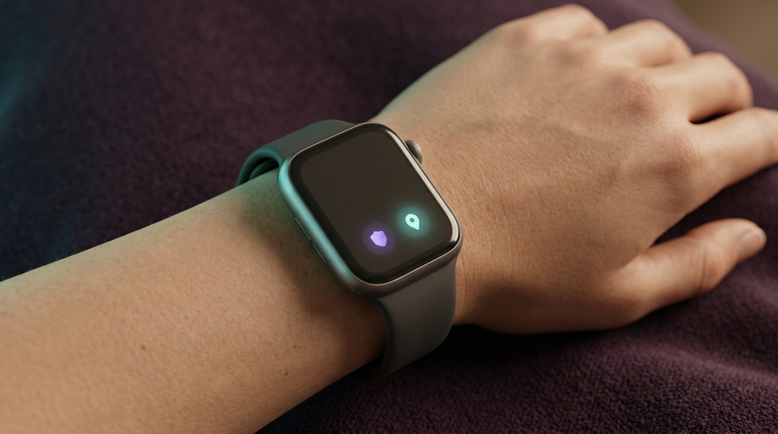
SIMULATED WEARABLE ACTIVATION
A discreet emergency request can begin from a smartwatch on the wrist
DISCREET
Tap or trigger without speaking
CONNECTED
Location and device status update
SIMULATED
Ready for future hardware integration
The watch is simulated for the prototype.

Slide 3
INTRODUCTION
03
From silent signal to coordinated help
Device Shield turns Lerato’s discreet activation into a structured emergency response.
01
Incident created
02
Location and city context
A unique incident ID and activation time are recorded.
Consented location and available real-time city data are brought together.
03
Response coordinated
04
Help monitored
The appropriate response pathway and nearest available responders can be identified.
Trusted responders receive updates while evidence, status and resolution are tracked.
The promise: a safer route from silent request to coordinated help.

Slide 4
CONTEXT
03
Domain and problem statement
DOMAIN
DOMAIN
!
PROBLEM STATEMENT
Gender-based violence (GBV) response and smart-city safety
Survivor protection • Crisis coordination • Real-time city data • Automated dispatch • Digital evidence • Location awareness • Simulated IoT / wearable monitoring
During a GBV incident, a survivor may not be able to make a conventional phone call or speak openly without increasing risk. Responders and trusted contacts may lack timely location, evidence and situational awareness, while fragmented tools delay intervention.
Device Shield turns a silent activation into a coordinated, trackable response using real-time city data and automated dispatch.
The opportunity
Create one secure web ecosystem that connects the person in danger, trusted responders and simulated devices through a shared incident record.

Slide 5
CONTEXT
04
Background information: why this matters
Emergency situations are time-critical, uncertain and difficult to communicate discreetly.
01
The person at risk
02
The trusted responder
03
The coordination gap
May be unable to call, speak openly, describe their location or gather evidence manually. A low-friction activation path is essential.
Needs a single, current view of what happened, where it happened, what evidence arrived and what action has already been taken.
Calls, messages, location sharing and device data are often fragmented. This makes handover, accountability and escalation harder.
Our response
A secure response hub connects discreet activation, live city data, evidence, location, automated dispatch and human response in one traceable workflow.

Slide 6
WHY DEVICE SHIELD
05
Strongest unique selling proposition
“A survivor can silently request emergency help — without speaking, making a phone call or visibly interacting with a device.”
SILENT
1. Silent activation
SMART
2. Appropriate response
NEAR
3. Nearest coordination
A custom keyword or discreet simulated trigger can initiate an incident when speaking or calling may be unsafe.
The platform combines the incident type, location, evidence and live city context to guide the right response pathway.
Real-time location and city data help coordinate the nearest available trusted responders or dispatch pathway.
This is the difference: not just an alert, but a discreet request-to-response coordination layer.

Slide 7
PURPOSE
06
What we want to do with this information
Translate the emergency-safety requirements into one visible, testable web experience — from activation to resolution.
01
1. Make the signal actionable
02
2. Coordinate the response
03
3. Prove the journey
Let survivors configure a discreet keyword and request help without relying on always-listening hardware.
Give trusted members a live dashboard with location, evidence, telemetry and response actions.
Persist every event, status change and audit record so judges can follow the complete lifecycle.
Outcome
A production-structured smart-city prototype that is honest about simulation today, while keeping the integration seams ready for real devices and dispatch systems tomorrow.

Slide 8
CORE CONCEPT
07
The experience: discreet signal → coordinated response
01
02
03
04
05
Configure
Activate
Notify
Collect
Resolve
→
→
→
→
User creates HELP, RED or a custom phrase.
Keyword, button, fall or sensor event triggers one incident service.
Trusted members receive an emergency alert with authorized context.
Location, evidence and simulated wearable telemetry arrive on a live timeline.
Members acknowledge, respond, escalate or resolve — with every action audited.
One incident model. Multiple activation sources. One shared source of truth.

Slide 9
PRODUCT SURFACE
08
Web application scope
USER
Emergency user portal
TEAM
Trusted-member console
DEMO
Demo operator controls
• Profile and emergency information
• Keyword configuration and test control
• Trusted-member network and invitations
• Location and evidence permissions
• Wearable/device management
• Incident history and audit trail
• Active emergencies and notifications
• City-data incident map and last known location
• Chronological evidence stream
• Latest wearable telemetry
• Acknowledge, respond, contact, escalate
• Resolve with resolution notes
• Simulate keyword detection
• Trigger wearable button or fall
• Accelerate evidence interval
• Move simulated location along route
• Toggle connectivity and retry queue
• View system health and audit logs

Slide 10
PRIMARY FLOW
09
Activation and incident lifecycle
1
2
3
4
5
STANDBY
ACTIVATED
COLLECTING
RESPONDING
RESOLVED
Ready
Signal received
Evidence live
Human action
Closed safely
⚡
Activation event
▣
Incident record
✓
Human response
Keyword HELP • wearable button • simulated fall
ID, user, time, method, priority, location
Acknowledge → Responding → Resolve

Slide 11
WHAT JUDGES WILL SEE
10
Live incident room
ACTIVE INCIDENT #INC-2048
● LIVE
LAST KNOWN LOCATION
TIMELINE
SIMULATED DEVICE
Mbombela, Mpumalanga
14:32:05 Keyword detected
SafeWatch Demo
Latitude −25.4745
Longitude 30.9703
Accuracy ±8 m
Updated 14:32:20
14:32:08 Members notified
● Connected Battery 78%
14:32:15 Audio received
Heart rate 92 BPM
Motion Walking
Fall detection Normal
GPS Available
14:32:30 Telemetry received
14:32:35 Acknowledged

Slide 12
COLLECTION AND TRANSMISSION
11
Evidence is a live, accountable stream
The prototype makes the 10-second concept observable — and lets the operator accelerate it for a fast demo.
EVIDENCE STREAM
DEMO INTERVAL 2 sec
●
Transmission indicator
14:32:15
Audio segment
UPLOADED
● LIVE — last evidence received 3 seconds ago
14:32:20
Location update
RECEIVED
14:32:25
Audio segment
UPLOADING
↻
Offline-ready behavior
14:32:30
Wearable telemetry
RECEIVED
Queue locally → preserve timestamp → retry → deduplicate on reconnect
14:32:35
Image frame
PENDING

Slide 13
DEVICE LAYER
12
Simulated IoT: honest now, replaceable later
Every hardware-dependent capability is clearly marked as simulated. The contract stays stable when real devices are introduced.
⌁
SafeWatch Demo
⚙
Triggers to demonstrate
↗
Future hardware seam
SIMULATED DEVICE
Connected • 78% battery
Heart rate: 92 BPM
Motion: Walking
Fall detection: Normal
GPS: Available
• Simulate wearable emergency button
• Simulate sudden / confirmed fall
• Generate changing heart rate
• Toggle weak or disconnected state
• Decrease battery during incident
• Move along a predefined route
Device adapter → telemetry contract → event bus → incident service
No redesign of the incident, notification or dashboard layers is required.

Slide 14
BACKEND AND DATA
13
Production-structured architecture
WEB APP
API
REAL-TIME
DATA
→
→
→
React + TypeScript
Responsive dashboard
Auth • incidents
Evidence • permissions
WebSockets / SSE
Presence + updates
PostgreSQL
Object storage
!
Notification service
⟳
Simulation engine
✓
Audit + authorization
Automated dispatch hooks, in-app alerts, email/SMS-ready notifications and status updates to trusted members.
Evidence scheduler, location route, IoT telemetry, offline queue and retry policy.
Role-based incident access, consent checks and immutable event history.

Slide 15
NON-FUNCTIONAL FOUNDATION
14
Trust, authorization and resilience
01
Authentication
02
Least privilege
03
Consent-aware sharing
Register, login, logout, reset and verification flows.
Trusted members only see incidents they are authorized to access.
Evidence, location and wearable permissions are explicit and configurable.
04
Reliable delivery
05
Auditability
06
Hardware honesty
Pending evidence, timestamps, retry states and duplicate protection.
Who activated, viewed, acknowledged, escalated or resolved — always traceable.
Every simulated signal is labeled; real adapters can be added later.

Slide 16
END-TO-END SCRIPT
15
The judge-ready demo journey
1
Configure
Set keyword HELP; add a trusted member; grant demo permissions.
2
Trigger
Click Simulate Keyword Detection — incident ID appears immediately.
3
Observe
Watch location, timeline, evidence interval and SafeWatch telemetry update.
4
Respond
Switch to trusted-member view; acknowledge, mark Responding and escalate if needed.
5
Interrupt
Toggle connectivity; show evidence queued as pending, then retry on reconnect.
6
Close
Resolve with notes; review complete incident history and audit events.

Slide 17
DELIVERY PLAN
16
Build priorities and definition of done
01
Phase 1 — foundation
02
Phase 2 — live response
03
Phase 3 — hardening
• Authentication and roles
• Profile and trusted members
• Keyword configuration
• Incident and timeline data model
• Responsive web shell
• Real-time incident updates
• City-data and dispatch integration
• Evidence scheduler and statuses
• Location map and route simulation
• Notifications and response actions
• Simulated wearable telemetry
• Offline queue and deduplication
• Authorization tests
• Audit log review
• Demo-mode controls
• Hardware adapter documentation
Definition of done
A judge can activate an incident, see the system react in real time, coordinate a response, interrupt connectivity, reconnect, and resolve the incident with a complete history.

Slide 18
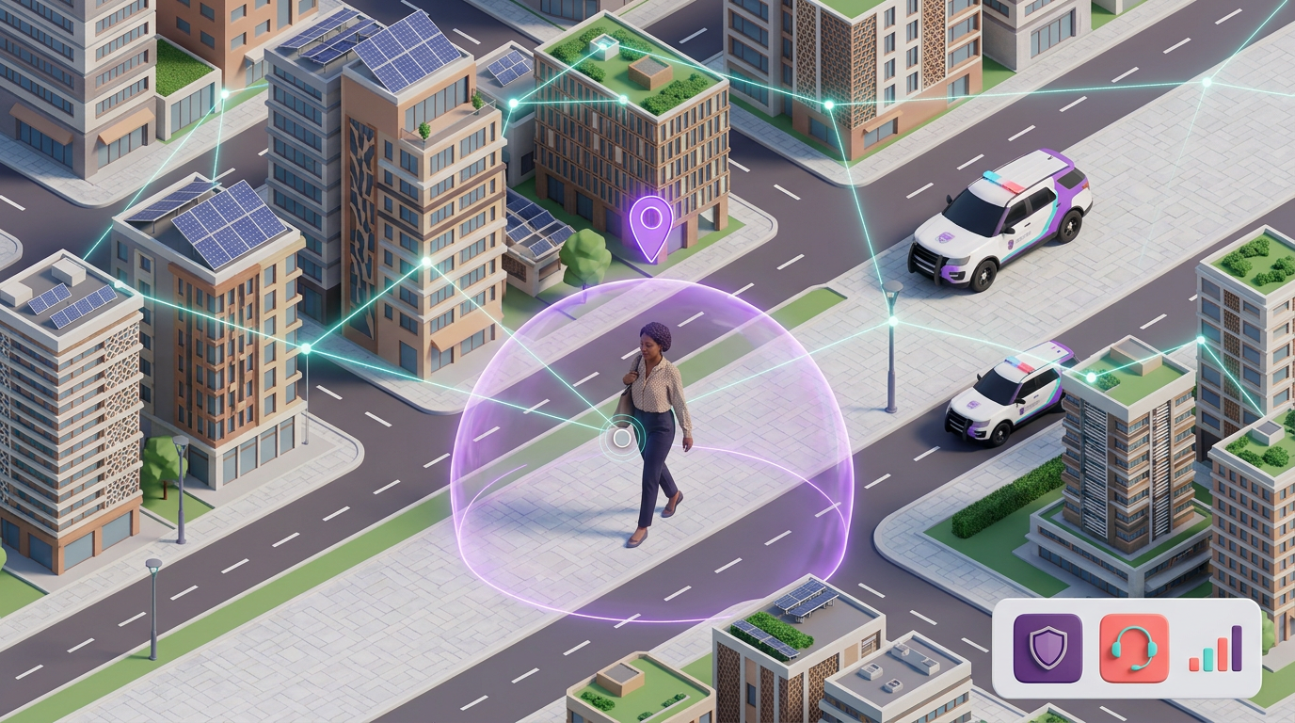
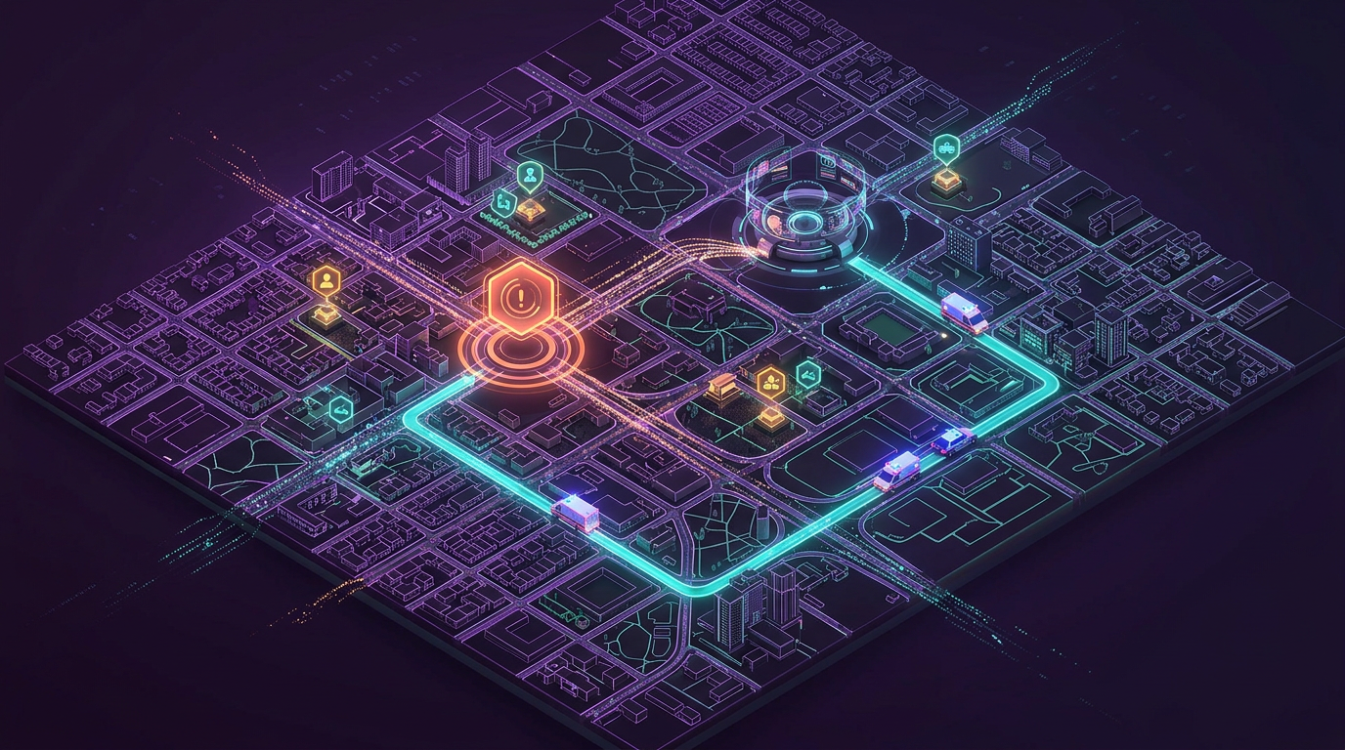

3D CONCEPT VISUALS
Visualising silent protection, smart-city intelligence and coordinated response
Silent survivor protection
Real-time city data + automated dispatch
Protect • Detect • Coordinate • Respond

